Slide 1

Get MAXIMUM from your data
Miroslav Černý
Advanced Analytics Consultant
Freelancer
mirek77@gmail.com

Slide 2
Data Mining Concept
A process of revealing hidden consequences in data.
Data -> Information -> Decision.
Traditional techniques may
be unsuitable due to
  Large amount of data
  High dimensionality of data
  Heterogeneous,
  distributed nature of data
AI
Machine Learning
Pattern Recognition
Statistics
Data Mining
Notes:
Exploratory analysis of observational data.
Data mining is the process of automatically discovering useful information in large data repositories. (Tan, Steinbach, Kumar, 2006)
A process of non-trivial retrieval of the implicit, formerly unknown and potentially useful information from data (Fayad et al., 1996).

Slide 3
Data Mining Tasks
Patterns describing the data
In general: predictive vs. descriptive
Classification (credit risk calculation)
Estimation (long-term customer value)
Segmentation (groups of subjects with similar behavior)
Shopping cart analysis (products being bought together)
Fraud detection (suspicious credit card transactions, claim validation)
Anomaly detection (aircraft systems monitoring during flight, medical systems)
Prediction (“Churn” – which customers will leave next year?)
Social networks mining, spatial data mining
Data quality mining (data quality measurement and improvement)
Predict unknown or future values

Slide 4
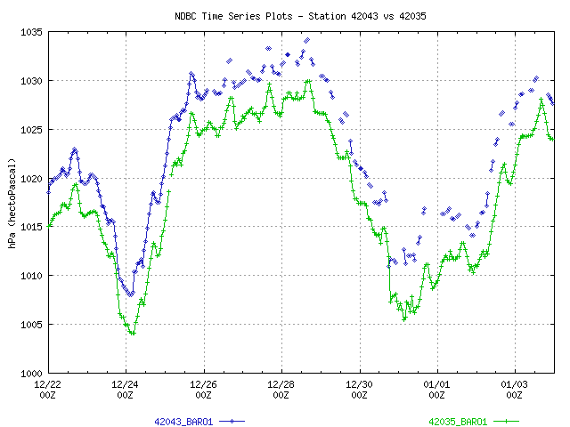
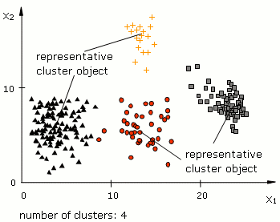
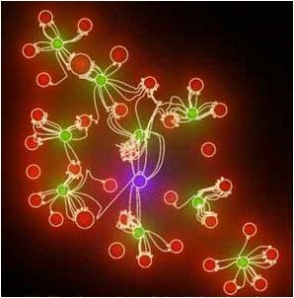
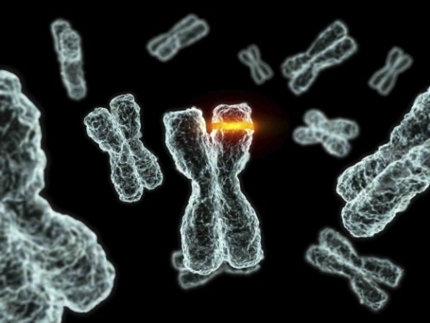
Data Mining Methods
Decision trees
Association analysis
Clustering
Graphical probabilistic models
Neural networks
Kohonen self-organizing maps
Support vector machine
Nearest neighbor
Non/linear regression
Logistic regression
Time series analysis
Genetic algorithms
Fuzzy modeling
GUHA, …

Slide 5
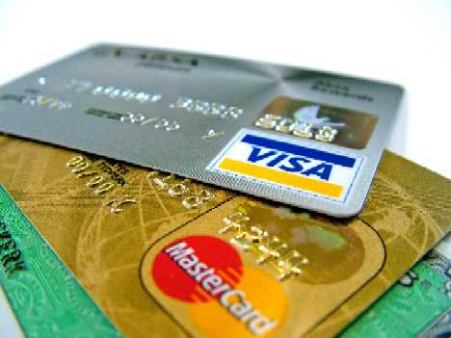


Areas of Data Mining Applications
Banking & insurance (fraud detection,
predicting customer life-time value, …)
Telecommunication (-||-)
Direct marketing
Supply chain management
eCommerce
Trading (technical analysis)
Scientific research
Medicine & healthcare (medical expert systems)
Technical fault diagnosis
…

Slide 6








Software for Data Mining
Commercial
  SPSS PASW Modeler / Clementine (http://www.spss.com/software/modeling/modeler/)
  SAS (http://www.sas.com/)
  Microsoft SQL server (http://www.microsoft.com/sqlserver/2008/en/us/default.aspx)
  Microsoft Excel 2007 (DM Add-In; http://www.microsoft.com/sqlserver/2008/en/us/data-mining-addins.aspx)
  Oracle DM (http://www.oracle.com/technology/products/bi/odm/index.html)
  Kxen (http://www.kxen.com/)
  …
OpenSource or Freeware
  Weka (http://www.cs.waikato.ac.nz/ml/weka/)
  R (http://www.r-project.org/)
  Orange (http://www.ailab.si/Orange/)
  LISP Miner (http://lispminer.vse.cz/)
  Ferda (http://ferda.wiki.sourceforge.net/)
  …

Slide 7
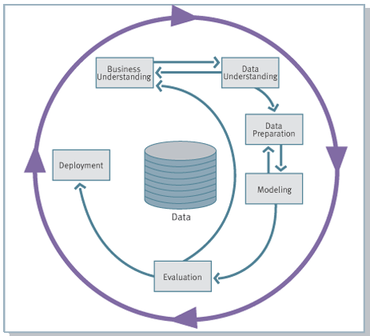
CRISP-DM: Methodology for Data Mining Projects

Slide 8

Benefits for Customers
Better business understanding
Increasing efficiency
Increasing safety, reliability
Competitive advantage
Notes:
⇒ Possibility of restructuring business processes.
⇒ Possibility of changing person’s mindset.
⇒ Possibility of increasing profit, decreasing risks, better financial stability.

Slide 9
Data Quality: a Critical Issue
“Garbage in, garbage out”
90% of time: data preparation (ETL)
10% of time: the DM itself
Data transformation issues
  Data ambiguity (e.g. Gender = ‘F’, ‘Female’, ‘woman’, ‘male’, ‘man’, etc.)
  Missing values
  Duplicate values
  Naming conventions of terms and objects
  Different currencies
  Different formats of numbers and text strings
  Referential integrity
  Missing dates

Slide 10

Risks
Unsure result
Data Mining can reveal already known or obvious facts
The result depends on data quality (errors) and distribution of values (skewness, kurtosis, ...)
Overfitting (model is not generalizing enough, it is too much trained to concrete data) can occur, but there are ways to minimize it.

Slide 11


Two types of errors
False positive (“a false alarm”)
  Stop the director to his company
False negative (“a small sensitivity”)
  A gunner entered to the company

Slide 12
Reference Case: Claim Handling Process
Electronic devices producer
Part of the Claim handling process currently performed manually
Opportunity to reduce the costs via automation
Need to identify the key attributes that influence either ACCEPTANCE or REJECTION of a claim and use them for further PREDICTION
Automatic check + A
35%
30%
No problem + A
224.900
636.800
186.000
33% manual, in the order of millions of EUR/year
13.700
2%
Rejected claims due to formal reasons
Overall: 45M claims × 33% ≈ 15M claims being handled manually
Automating most of the manual work with DM would save sum of money in the order of millions of EUR/year

Slide 13
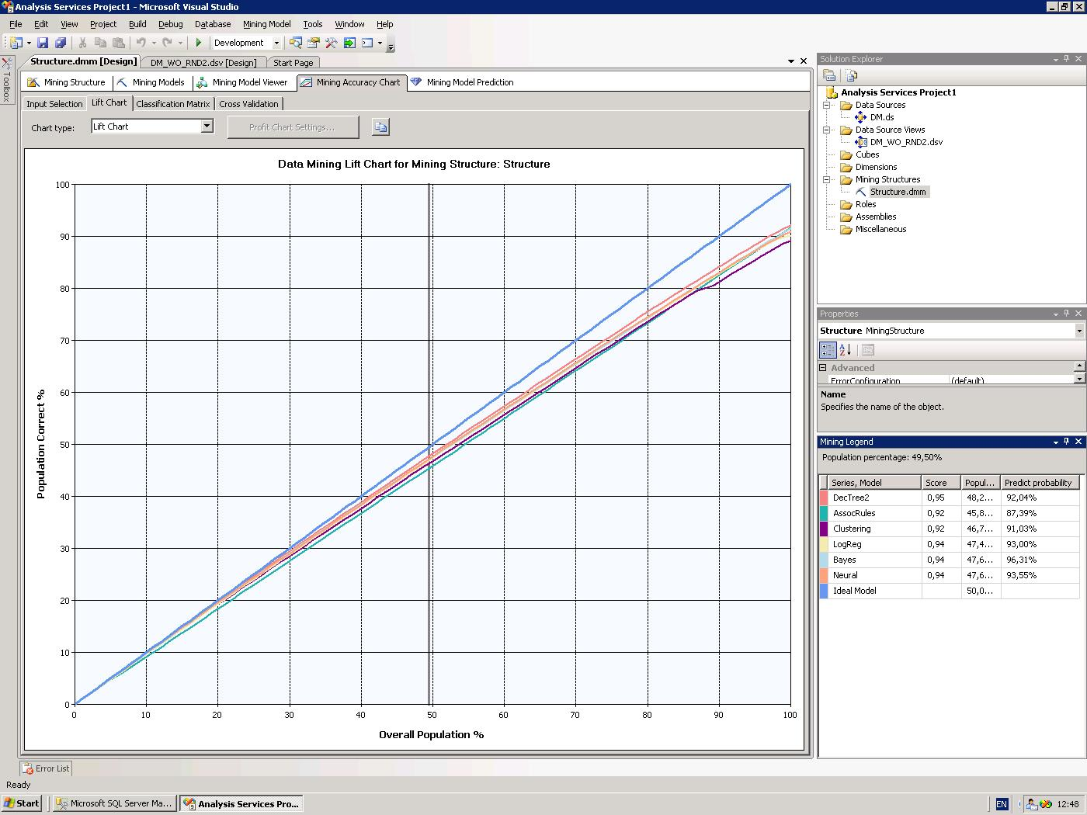
Predictive DM Models with Highest Prediction Accuracy
Up to 95%

Slide 14
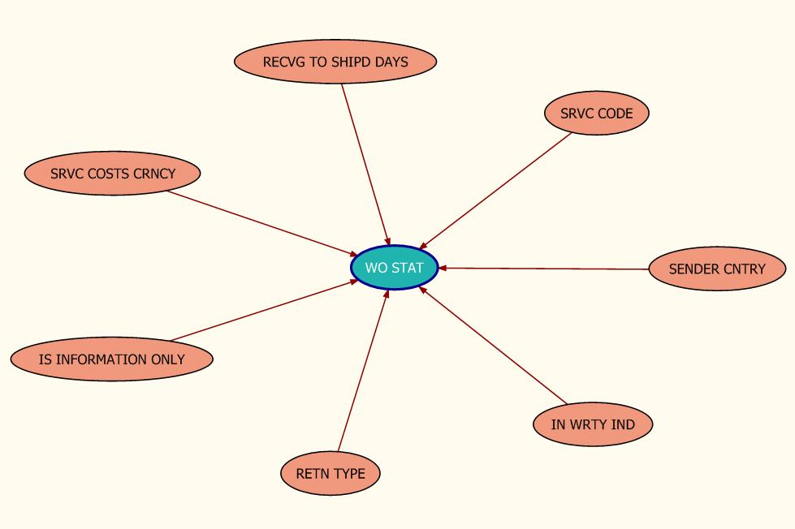
Just few attributes really needed

Slide 15
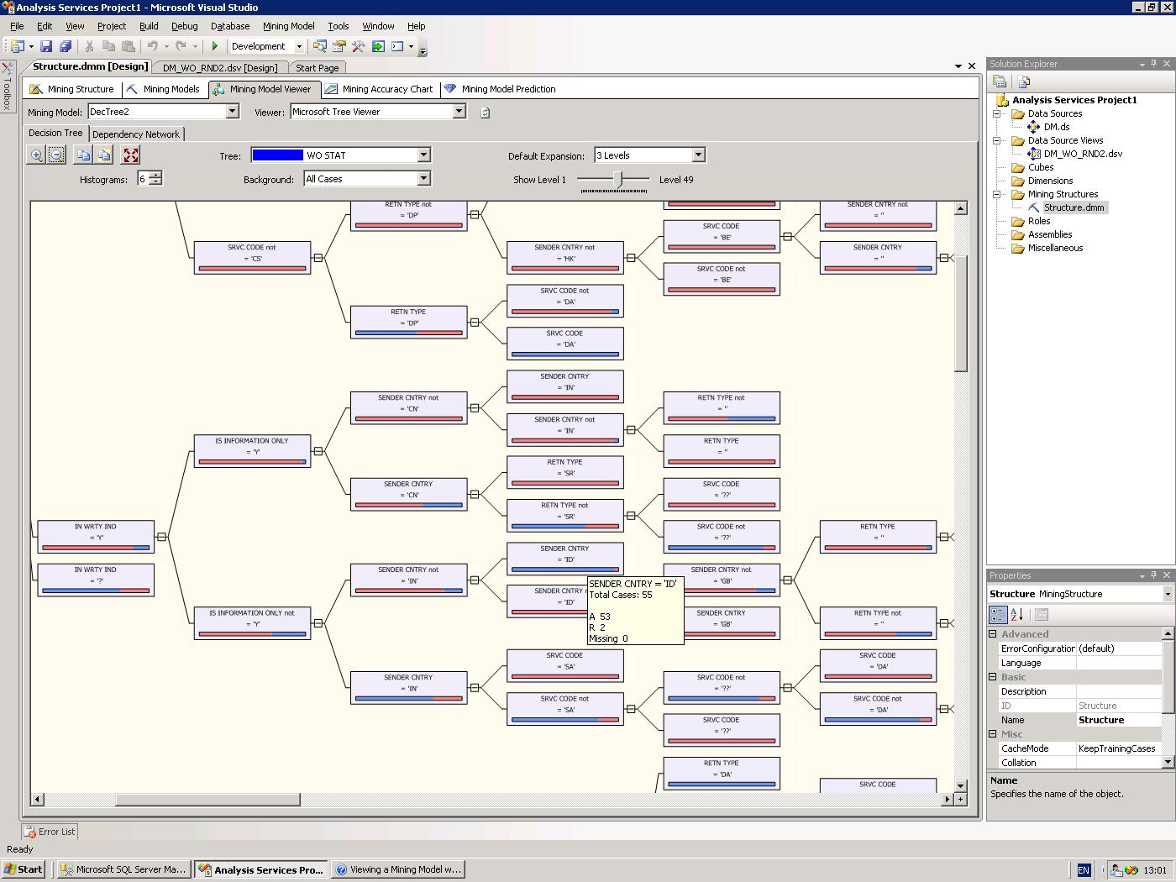
Decision Tree Detail

Slide 16
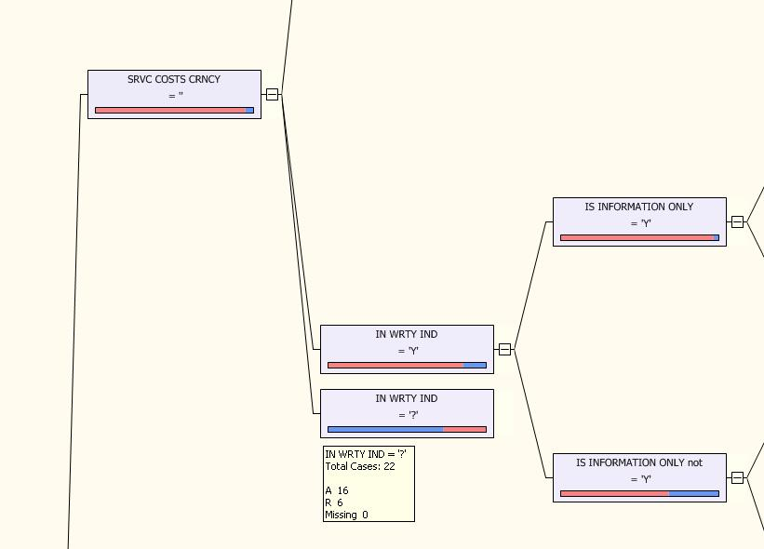
Anomaly (Fraud) Detection

Slide 17
Benefits for Customer
Automation of claim handling process and therefore saving money
Speeding-up the process
Reducing complexity without impacting the result
Better understanding of what are the real key factors of the decision process
Identifying suspicious exceptions in the decision process (fraud detection)
Optimizing the process to be more accurate in terms of whether a claim should be accepted or rejected

Slide 18
Churn prediction
Business goal: Create a model, which every month identifies customers, who want to leave to competition in two months. The model will use historical data about customers behavior.
Data understanding: 1% of customers leave every month. Churn appears as a canceled utility contract.
Historical data
(Previous months)
Regular predictions
(Current month)
Marketing campaign
(Next month)
Potential churn
(Next 2 months)

Slide 19

Tieto PreDue
Save € 1 000 000 ++ / year by
  Finding customers, who default on invoice payment BEFORE it happens
  Taking preemptive actions on 10% of your clients
  Prioritizing collections
Bonus:
Company Reputation & Customer Satisfaction
How it works >>
http://www.research.ibm.com/dar/papers/pdf/equitant-kdd08.pdf

Slide 20
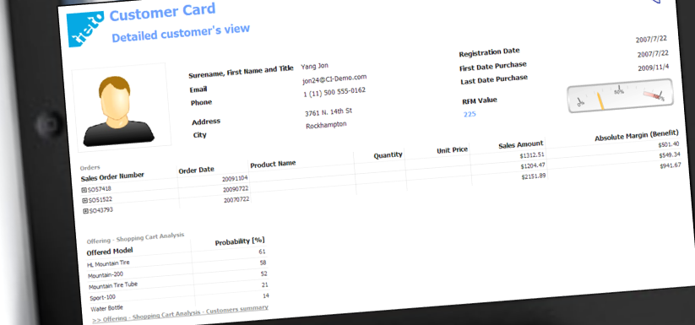
Salespeople with an iPad...
...can make targetted offers.
A predictive model tells them, which products are most relevant for each customer.

Slide 21
Excell with Excel
Instant Customer Insight
Behavioral Segmentation
What makes your clients behave like they do?
Instant automated Revenue/Cost estimation
-> Simple and reasonable predictive modeling
All-In-One Excel file
Like that one >>>>>

Slide 22
Evaporation – Advanced Control
Optimal LIMITED District Heat
Optimal Input Liquor Load
Proposed by Model
Control
Maximized EVAP Load
EVAP
Optimal Fresh Steam Load
Proposed by Model
EVAP plant Model
Analytical Datamart
OSI Soft PI

Slide 23
Embedded approach
Market direction prediction
Trading system NeuroGather

Slide 24

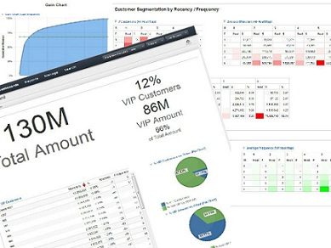
Cloud / SaaS approach
Customers behavioral segmentation (RFM Analysis)
Revenue forecasting

Slide 25
Challenges & Pitfalls
Noisy data
Look-ahead bias
Data-snooping bias
Survivorship bias
Sample size
Discipline to follow the model
Changes in performance over time
Explaining data mining to others
Notes:
Data snooping
Refining model on the training dataset must bring also a refinement on the testing dataset
Use fundamental truths rather than trial & error
Survivorship – when not all tags were available or used the same way in the past; Representativeness of training dataset
Sample size = 252 x # of free parameters

Slide 26
Mitigating Data-snooping bias
Sample size at least 252 x number of free parameters
Out-of-sample testing
Sensitivity analysis – change parameters by e.g. 25%
Simplifying the model
Eliminating some parameters

Slide 27
Thank you
Miroslav Černý
Advanced Analytics Consultant
Freelancer
mirek77@gmail.com

